Slide 1

Evaluating Effectiveness
Imagine a peer, Taylor, who is new to Fidelity has asked for feedback on their first-ever Individual Practice Plan. Taylor has sent their plan to you ahead of the meeting for you to review so that you can identify what they did well and areas of opportunity for improvement based on Individual Practice Plan best practices.
Next

Slide 2



Evaluating Effectiveness
In preparation for your meeting with Taylor, review each section of their Individual Practice Plan and rate it using the following scale:
It does not follow best practices and needs significant revision to be effective.
It could use a little refinement, but overall it is in good shape for Taylor to use this year.
It follows best practices and will set Taylor up for success this year.
After you make your selection, you will hear from Taylor on how they feel about the feedback and their next steps.
Back
Next

Slide 3
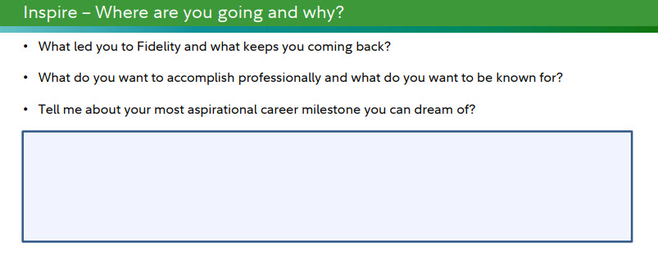
Review the Inspire section of Taylor’s Individual Practice Plan, then select a rating for this section.
I came to Fidelity because I knew they would have all kinds of great opportunities to grow once I got my foot in the door. My most aspirational goal is to get a new role to be able to afford my dream home.
It does not follow best practices and needs significant revision to be effective.
It could use a little refinement, but overall it is in good shape for Taylor to use this year.
It follows best practices and will set Taylor up for success this year.
Back
Next

Slide 4
Great evaluation! This section of Taylor's Individual Practice Plan needs significant revision to follow best practices. It needs to be professionally focused, include relevant milestones, and include more specificity on what they want to accomplish this year and why.
Back
Next

Slide 5
Not quite. Taylor did generally mention career aspirations, but from a very personal perspective that doesn't lend to skill development or growing into their professional brand. This will lead to commitments that are not relevant to the purpose of an Individual Practice Plan and make identifying skills and resources to help them difficult.
Back
Next

Slide 6
That feedback is contradictory to the best practices of specificity, professionally focused, and being reasonably attainable within the performance year.
Back
Next

Slide 7
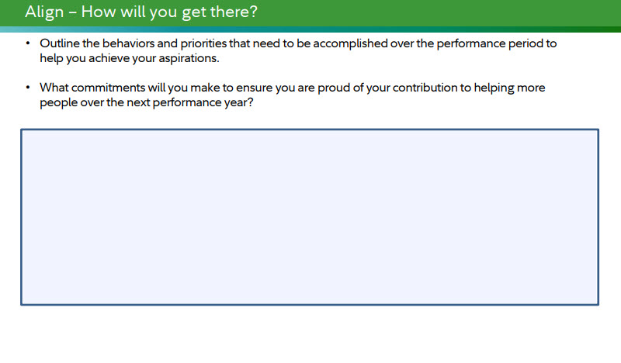
Review the Align section of Taylor’s Individual Practice Plan, then select a rating for this section.
If I focus in on moving into a new role, there is a lot that I need to do to get there and it could take more than one year. I guess by the end of this year I will want to have grown my professional network to expand outside of my current team, and make sure that my personal brand is authentic, professional, and positive. This would help me by having a larger network but also potentially help me when I need some additional guidance, support, or diverse perspectives to make sure I'm providing the best service that I can.
It does not follow best practices and needs significant revision to be effective.
It could use a little refinement, but overall it is in good shape for Taylor to use this year.
It follows best practices and will set Taylor up for success this year.
Back
Next

Slide 8
Not quite. There are parts of Taylor's Align section that are close to meeting best practices, such as professional alignments and being specific in some of their responses around how networking would help them grow, but also parts of this section that need further refinement, such as adding how their commitments will ensure they're supporting the business goal of "help more people" and being more deliberate in their commitments as opposed to phrasing such as "I guess".
Back
Next

Slide 9
That is helpful feedback! Taylor's Ailgn component lacks specific behaviors and commitments needed to achieve their professional aspirations, they did a great job aligning their response in this section to the Inspire section of their plan.
Back
Next

Slide 10
Not quite. Not quite. There are parts of Taylor's Align section that are close to meeting best practices, such as professional alignments and being specific in some of their responses around how networking would help them grow, but also parts of this section that need further refinement, such as adding how their commitments will ensure they're supporting the business goal of "help more people" and being more deliberate in their commitments as opposed to phrasing such as "I guess".
Back
Next

Slide 11
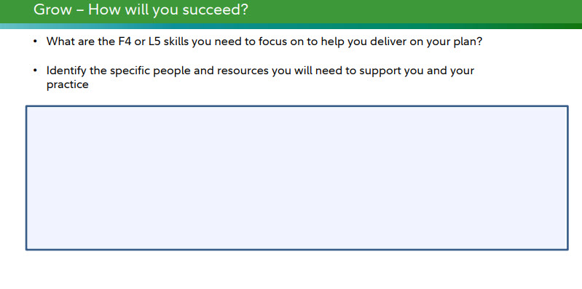
Review the Grow section of Taylor’s Individual Practice Plan, then select a rating for this section.
If I am focusing on developing my personal brand and expanding my network, there are a lot of L5 skills, people, and resources I can leverage.
- L5: Emotional Intelligence
- L5: Executive Presence
- L5: Building Relationships and Trust
- My leader, who can help direct me to networking opportunities and potentially support me in helping with special projects that would showcase my brand and expertise
- My ERGs, which have all kinds of networking events and opportunities to connect with others outside of my group
It does not follow best practices and needs significant revision to be effective.
It could use a little refinement, but overall it is in good shape for Taylor to use this year.
It follows best practices and will set Taylor up for success this year.
Back
Next

Slide 12
That feedback contradicts Individual Practice Plan best practices. Taylor's response in this section is specific, attainable, aligned to their commitments, and more strategic than tactical.
Back
Next

Slide 13
Not quite. Taylor's response in this section is specific, attainable, aligned to their commitments, and more strategic than tactical, all of which are great qualities to have in the Grow section of an Individual Practice Plan.
Back
Next

Slide 14
Great feedback! Taylor's response to the Grow section is supportive of the Inspire and Align commitments, provides a prioritized list of the important skills to develop, and is inclusive of people and resources who can help them achieve their commitments.
Back
Next

Slide 15
Start Over
Exit

